Slide 1
Classification – Logistic Regression
Dr. Mehmet Yasin Ulukuş

Slide 2
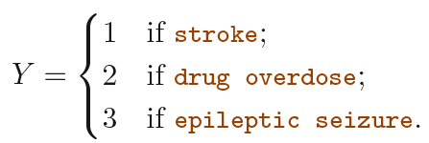
Why not Linear Regression?
Suppose that we are trying to predict the medical condition of a patient in the emergency room on the basis of her symptoms
Three possible diagnoses: stroke, drug overdose, and epileptic seizure
We could consider encoding these values as a quantitative response variable, $Y$, as follows:

Slide 3
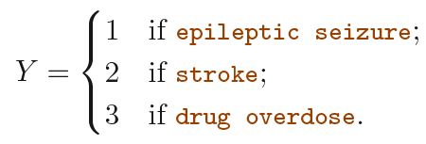
Why not Linear Regression?
Suppose that we are trying to predict the medical condition of a patient in the emergency room on the basis of her symptoms.
Three possible diagnoses: stroke, drug overdose, and epileptic seizure.
We could consider encoding these values as a quantitative response variable, Y , as follows and use least square to fit regression:
This coding implies an ordering on the outcomes but there is no particular reason that this needs to be the case.
Why not this coding then?

Slide 4
Why not Linear Regression?
1, 2, 3 coding would be reasonable.
If the response variable’s values take on a natural ordering, such as mild, moderate, and severe.
Also if we felt the gap between mild and moderate was similar to the gap between moderate and severe.
Unfortunately, in general there is no natural way to convert a qualitative response variable with more than two levels into a quantitative response that is ready for linear regression.

Slide 5
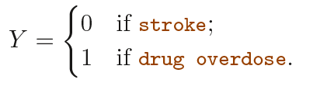
Why not Linear Regression?
For a binary (two level) qualitative response, the situation is better.
If there are only two possibilities: stroke and drug overdose
We could then fit a linear regression to this binary response, and predict drug overdose if $\hat{Y}>0.5$and stroke otherwise.
Regression by least squares does make sense for binary response.
It can be shown that the $X\hat{β}$obtained using linear regression is in fact an estimate of $P(drug overdose|X)$in this special case.

Slide 6
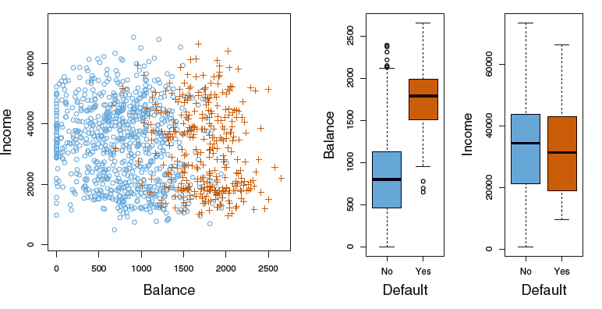
Logistic Regression

Slide 7
Logistic Regression
Rather than modeling this response $Y$ directly, logistic regression models the probability that $Y$ belongs to a particular category
For the Default data, logistic regression models the probability of default for example given a balance.
$$P\left(default=Yes | balance\right)$$
which we abbreviate $p(balance)$
Now we can use these probabilities to classify individuals. For example, we might classify customers with a $p\left(balance\right)>0.5$ as default yes customers
Alternatively, if a company wishes to be conservative in predicting individuals who are at risk for default, then they may choose to use a lower threshold, such as $p(balance)>0.1$ to call them default yes.

Slide 8
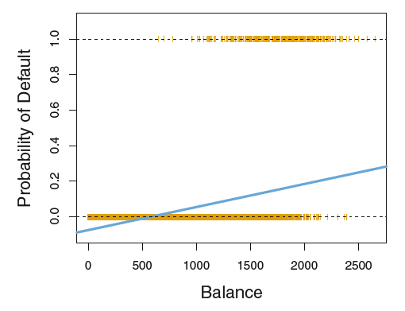
Logistic Regression
For simplicity, let $p(x)=P(Y=1|x)$
We talked of using a linear regression model to represent these probabilities
$$p\left(X\right)= β_{0} + β_{1}X.$$
This approach might provide values less than zero and greater than 1.

Slide 9
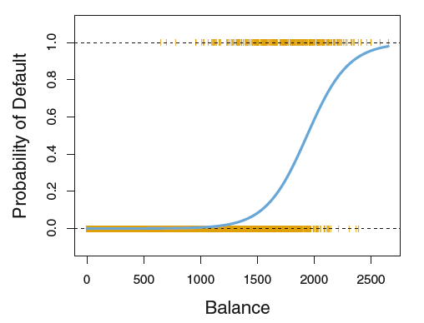
Logistic Regression
To avoid this problem, we must model $p(X)$ using a function that gives outputs between 0 and 1 for all values of $X$
In logistic regression, we use the logistic function
$p\left(X\right)=\frac{e^{β_{0}+β_{1}X}}{1+e^{β_{0}+β_{1}X}}$
The logistic function will always produce an S-shaped curve of this form, and so regardless of the value of X, we will obtain a sensible prediction

Slide 10
Logistic Regression
After a bit of manipulation, we find that
$$\frac{p\left(X\right)}{1−p(X)}=e^{β_{0}+β_{1}X}$$
$\frac{p\left(X\right)}{1−p(x)}$is called odds which can take on any value between 0 and $∞$.
Terminology is used in gambling
On average nine out of every ten people with an odds of 9 will default, since $p(X)=0.9$implies an odds of $\frac{0.9}{1−0.9}=9$

Slide 11
Logistic Regression
By taking the logarithm, we arrive at
$$log⁡\left(\frac{p\left(X\right)}{1−p\left(X\right)}\right)=β_{0}+β_{1}X$$
So logarithm of odds are modeled by a linear function
One unit increase on $X$ will multiply the odds by $e^{β_{1}}$
Higher odds means higher probabilities
If $β_{1}$is positive then increasing $X$ will be associated with increasing $p(X)$, and is negative then increasing $X$ will be associated with decreasing $p(X)$

Slide 12
Logistic Regression: Estimating Coefficients
The coefficients $β_{0}$ and $β_{1}$ are unknown, and must be estimated based on the available training data
We prefer general method called maximum likelihood
The basic intuition behind using maximum likelihood for logistic regression is as follows:
We seek estimates for $β_{0}$ and $β_{1}$ such that the predicted probability $\hat{p}(x_{i})$of default for each individual, corresponds as closely as possible to the individual’s observed default status.

Slide 13
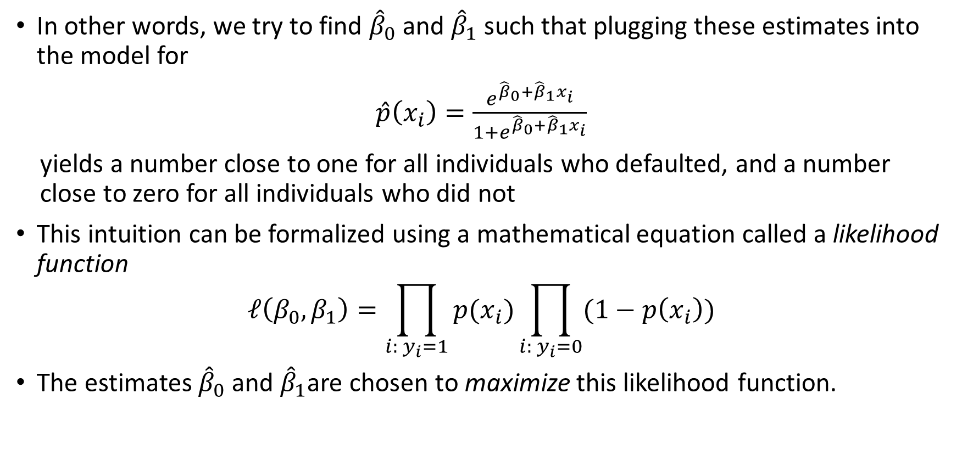
Logistic Regression: Estimating Coefficients
In other words, we try to find ${\hat{β}}_{0}$ and ${\hat{β}}_{1}$ such that plugging these estimates into the model for
$\hat{p}\left(x_{i}\right)=\frac{e^{{\hat{β}}_{0}+{\hat{β}}_{1}x_{i}}}{1+e^{{\hat{β}}_{0}+{\hat{β}}_{1}x_{i}}}$
yields a number close to one for all individuals who defaulted, and a number close to zero for all individuals who did not
This intuition can be formalized using a mathematical equation called a likelihood function
$$ℓ\left(β_{0},β_{1}\right)=\prod_{i: y_{i}=1}{p(x_{i})}\prod_{i: y_{i}=0}{(1−p\left(x_{i}\right))}$$
The estimates ${\hat{β}}_{0}$ and ${\hat{β}}_{1}$are chosen to maximize this likelihood function.

Slide 14
Logistic Regression: Estimating Coefficients
Instead of maximizing likelihood, we can maximize the log-likelihood (true for any increasing function) to get rid of multiplications.
The log-likelihood can be written as
$$log⁡(ℓ\left(β_{0},β_{1}\right))=\sum_{i=1}^{N}{y_{i}(\log\left(p\left(x_{i}\right)\right)+\left(1−y_{i}\right)log(1−p(x_{i}))}$$
The estimates ${\hat{β}}_{0}$ and ${\hat{β}}_{1}$are chosen to maximize log-likelihood function.
Log-likelihood function is concave.
Take derivatives with respect to $β_{0}$ and $β_{1}$and set to zero and solve the equation system.
Equation system is non-linear but there are iterative algorithms that can solve this system (Newton-Raphson).

Slide 15
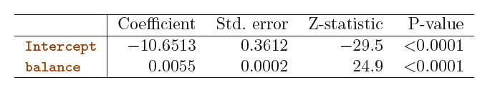
Logistic Regression: Default Data Model
For the Default Data the logistic regression parameters are as follows:
We see that ${\hat{β}}_{1}=0.0055$; this indicates that an increase in balance is associated with an increase in the probability of default
To be precise, a one-unit increase in balance is associated with an increase in the log odds of default by 0.0055 units
R provides these values Scikit Learn does not.

Slide 16
Logistic Regression: Predictions
Once the coefficients have been estimated, it is a simple matter to compute the probability of default for any given credit card balance
We predict that the default probability for an individual with a balance of $1,000 is
$$\hat{p}\left(X\right)=\frac{e^{{\hat{β}}_{0}+{\hat{β}}_{1}x_{i}}}{1+e^{{\hat{β}}_{0}+{\hat{β}}_{1}x_{i}}}=\frac{e^{−10.6513+0.0055×1000}}{1+e^{−10.6513+0.0055×1000}}=0.005759$$
In contrast, the predicted probability of default for an individual with a balance of $2,000 is much higher, and equals 0.586 or 58.6%

Slide 17
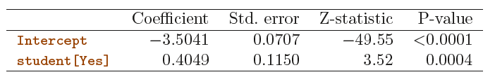
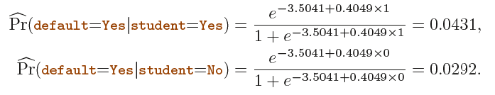
Logistic Regression: Qualitative inputs
One can use qualitative predictors with the logistic regression model using the dummy variable approach we have seen in linear regression
As an example, the Default data set contains the qualitative variable student
To fit the model we simply create a dummy variable that takes on a value of 1 for students and 0 for non-students
Fitted model is as follows
Predictions are as follows:

Slide 18
Multiple Logistic Regression
We now consider the problem of predicting a binary response using multiple predictors
Our model is now is a generalization of the single model
$$\log\left(\frac{p\left(X\right)}{1−p\left(X\right)}\right)=β_{0}+β_{1}X_{1}+…+β_{p}X_{p}$$
where $X=(X_{1}, . . .,X_{p})$are $p$ predictors
Probabilities are computed by
$$p\left(X\right)=\frac{e^{β_{0}+β_{1}X_{1}+…+β_{p}X_{p}}}{1+e^{β_{0}+β_{1}X_{1}+…+β_{p}X_{p}}}$$
We use the maximum likelihood method to estimate $β_{0}, β_{1}, . . . , β_{p}$

Slide 19
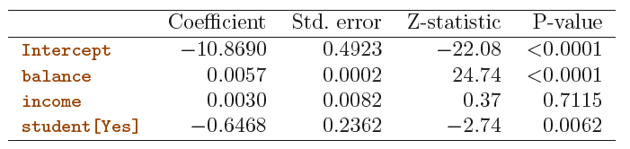

Multiple Logistic Regression
Table below shows the coefficient estimates for a logistic regression model that uses balance, income (in thousands of dollars), and student status to predict probability of default
The p-values associated with balance and the dummy variable for student status are very small, indicating that each of these variables is associated with the probability of default
For example, a student with a credit card balance of $1,500 and an income of $40,000 has an estimated probability of default of

Slide 20
Multiple Logistic Regression Classification
We estimate probabilities using
$$p\left(X\right)=\frac{e^{β_{0}+β_{1}X_{1}+…+β_{p}X_{p}}}{1+e^{β_{0}+β_{1}X_{1}+…+β_{p}X_{p}}}$$
Now, we can use thresholds to assign classes
For instance, if $P\left(x\right)>0.5,$then $Y=1$
It can be rewritten as, if $\log\left(\frac{p\left(x\right)}{1−p\left(x\right)}\right)=β_{0}+β_{1}x_{1}+…+β_{p}x_{p}>0,$ then $Y=1$.
Now, note that $β_{0}+β_{1}x_{1}+…+β_{p}x_{p}$ is linear, hence the decision boundary is linear.
$$β_{0}+β_{1}x_{1}+β_{2}x_{2}<0$$
$$β_{0}+β_{1}x_{1}+β_{2}x_{2}>0$$

Slide 21
Logistic Regression Python Example
See Logistic Regression Jupyter Notebook File for details.

Slide 22
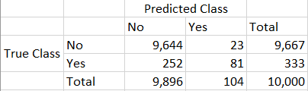
CONFUSION MATRIX
A confusion matrix, shown below for the Default data, is a convenient way to display this information
In total 275 individuals among 10,000 are misclassified
Only 23 out of 9,667 of the individuals who did not default were incorrectly labeled
However, of the 333 individuals who defaulted, 252 (or 75.7%) were missed
From the perspective of a credit card company that is trying to identify high-risk individuals would be unacceptable

Slide 23
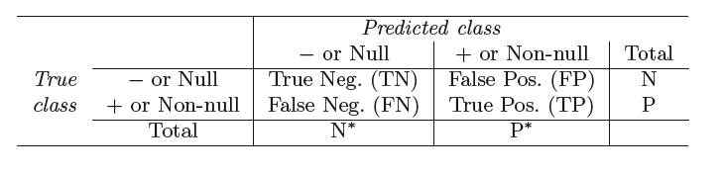
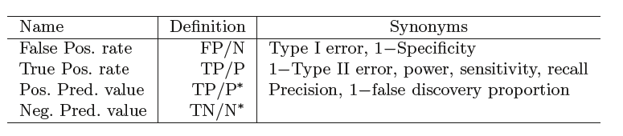
Types of Clasification Errors Summary
Possible results when applying a classifier or diagnostic test to a population
People use different terminology for these errors.

Slide 24
Setting Different Thresholds
As we have seen, Logistic Regression is trying to approximate the Bayes classifier
That is, the Bayes classifier will yield the smallest possible total number of misclassified observations, irrespective of which class the errors come from
In contrast, a credit card company might particularly wish to avoid incorrectly classifying an individual who will default, whereas incorrectly classifying an individual who will not default, though still to be avoided, is less problematic
We will now see that it is possible to modify it in order to develop a classifier that better meets the credit card company’s needs

Slide 25
Setting Different Thresholds
In the two-class case, this amounts to assigning an observation to the default class if
However, if we are concerned about incorrectly predicting the default status for individuals who default, then we can consider lowering this threshold
For instance, we might label any customer with probability of default above 20% to the default class
To do this all we need to compute the probabilities generated by the logistic regression model and classify customers as defaulters if the predicted probability is 0.2.
Pr(default = Yes|X = x) > 0.5
Pr(default = Yes|X = x) > 0.2

Slide 26
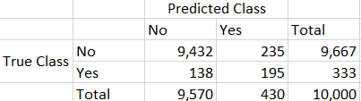
Setting Different Thresholds
Now we have the following confusion matrix
Of the 333 individuals who default, we correctly predict all but 138, or 41.4%.
This is a vast improvement over the error rate of 75.7% that resulted from using the threshold of 50%.
However, this improvement comes at a cost: now 235 individuals who do not default are incorrectly classified.
As a result, the overall error rate has increased slightly to 3.73 %.
Preferrable for credit card company

Slide 27
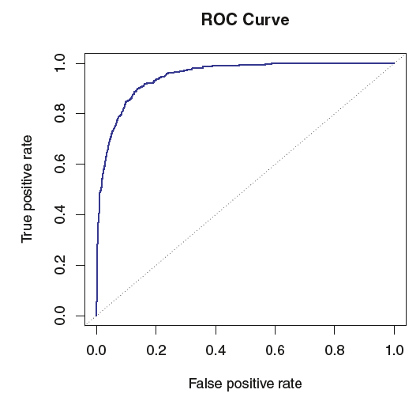
ROC Curves
The ROC curve is a popular graphic for simultaneously displaying the two types of errors for all possible thresholds
ROC is an acronym for receiver operating characteristics
The overall performance of a classifier, summarized over all possible thresholds, is given by the area under the (ROC) curve (AUC)
An ideal ROC curve will hug the top left corner, so the larger area under curve the better the classifier

Slide 28
Logistic Regression Confusion Matrix and ROC Python Example
See Logistic Regression Jupyter Notebook File for details.

Slide 29
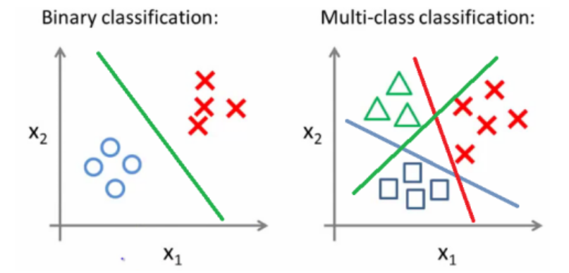
Multi Class Classification
Just as binary classification involves predicting if something is from one of two classes (e.g. “black” or “white”, “dead” or “alive”, etc.),
Multiclass problems involve classifying something into one of N classes (e.g. “red”, “white” or “blue”, etc).
Similarly if we had the option to have the exact probability distribution we can still use The Bayes Optimal
The classifier would basically pick the class $j$ where the conditional probability is the highest
$$\max_{j∈ 𝒩}{P\left(Y=j | X=x_{0}\right)}$$

Slide 30
Multi Class Classification
See Multi Class Classification Jupyter Notebook File for details.

Slide 31
Logistic Regression: Non Linear Decision Boundaries
Just as in the Linear regression, similar non-linear transformation can be done in logistic regression.
For example let’s say we have two independent variables $X_{1},X_{2}$.
Instead of a linear model, we may choose a 2nd order polynomial. Hence the model will look like as follows.
$$\log\left(\frac{p\left(X\right)}{1−p\left(X\right)}\right)=β_{0}+β_{11}X_{1}+β_{12}X_{1}^{2}+β_{21}X_{2}+β_{22}X_{2}^{2}$$
Note that the above model may again be treated as a linear model but with four independent variables $\left(X_{1},X_{2},X_{1}^{2},X_{2}^{2}\right).$
The decision boundary created by this model will be a second order polynomial.

Slide 32
Logistic Regression: Non Linear Decision Boundaries

